Slide 1
Somacast
A privacy-first, on-device app that listens for 10 seconds, detects cognitive overload, and quickly delivers a science-backed micro-intervention (breathing, grounding, or pacing) providing relief.

Slide 2

Impact and Usefulness in Real World
Addresses the rising real-world need for accessible stress regulation
Detects cognitive overload early - before it becomes burnout, panic, or performance decline.
Provides immediate, science-backed relief through micro-interventions users can perform anywhere.
Supports high-stress professionals who need fast stabilization during demanding tasks.
Empowers users with self autonomy: real mental-state detection without sacrificing privacy or relying on cloud-based analytics.

Slide 3
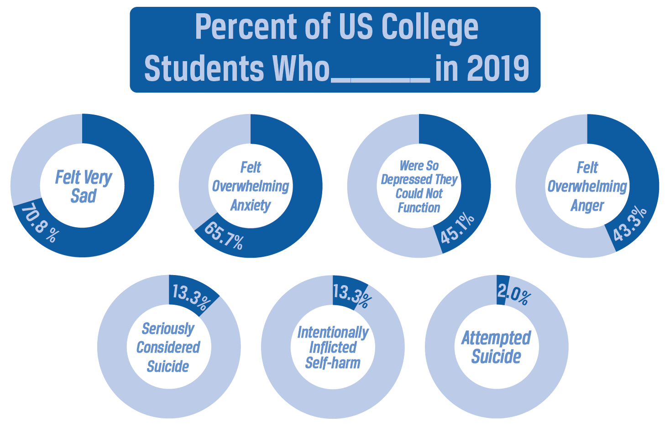
Business and Strategy
Positioned at the intersection of mental wellness, AI health tooling, and privacy-first tech - three fast-growing markets.
Differentiates from competitors through on-device processing, eliminating the trust issues that plague mental-health AI apps.
Monetization paths include subscription (pro features) and enterprise partnerships (corporate wellness)
Brand strategy centers on safety, trust, and scientific credibility - critical for adoption in healthcare- and productivity-focused verticals.

Slide 4
Technicals & Models Used
FRONTEND
Next.js (React + TypeScript) as the main framework for a fast, server-rendered web app.
Tailwind CSS for utility-first styling and rapid UI iteration.
Vercel hosting for edge-optimized frontend deployment.
BACKEND:
Web Speech API: Browser-native speech recognition.
Hugging Face API Routes: robust sentiment analysis/NLP frameworks.

Slide 5
Demo

Slide 6
Thank you for Listening
Q&A

